Slide 1
GMAS
FIRST Release:
Update
RAS Friday
March 16, 2018
Sheila Doyle, Portfolio Team Manager, OSP Research Finance

Slide 2
What is FIRST?
F
I
R
S
T
inancial
nvoicing &
eporting
trategic
ransition

Slide 3
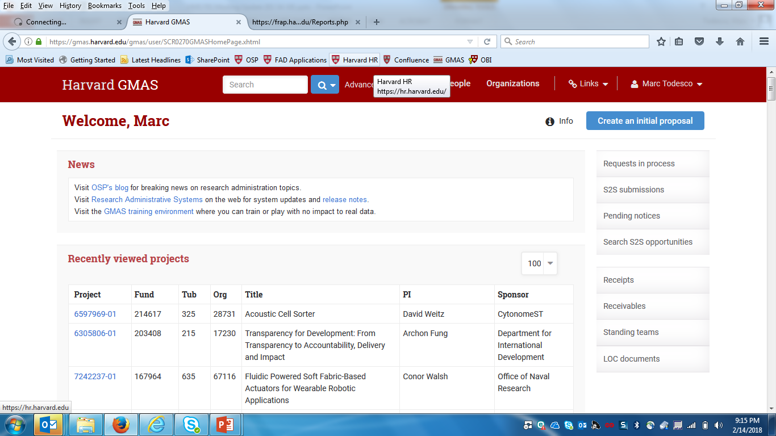
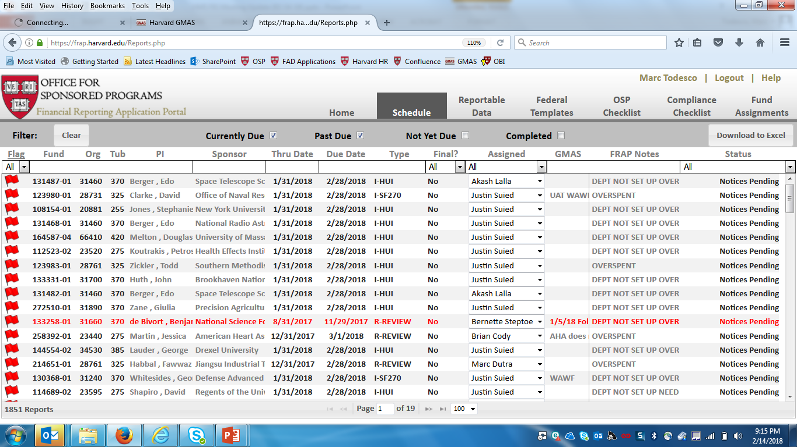
What is FIRST?
F.I.R.S.T. Project

Slide 4
What did FRAP accomplish?
Automated 70% of Monthly Deliverables
Proof of Concept
Fulfilled Business Need
Reduced Administrative Burden
Improved Accuracy and Timeliness
Allowed OSP Staff to Refocus on Value-Add Activities
  Collections to reduce receivables
  Reduction to past due and unreconciled
  Increased engagement with clients

Slide 5

FRAP Challenges
Not Built to HUIT or Industry Standards
Cumbersome to Support and Update
Technically Inadequate Infrastructure
  Issues Require Reverse Engineering
Unreliable Availability
Poses Financial and Institutional Risk
  Full System Failure = Manual Process
FRAPtop

Slide 6
GMAS Release I: April 9th
Transition FRAP Automation into GMAS
  9,000 financial deliverables prepared annually, 70% automated
  Mitigate Risk: Accuracy and timeliness
Retire FRAP (FRAPtop)
  One less system!
  Reduce financial and institutional risk
Improve Post-Award Workflow
  Scheduling
  Preparing
  Approving
  Document Retention
Increase Transparency and Visibility to Clients
  Real-time status of financial deliverables, preview of invoices/reports
FRAPtop

Slide 7
Additional Monthly GMAS Releases:
May, June, and July
Enhancements
  Improve post-award workflow
  Scale-up automation
  Compliance Checklist
  GMAS as a communication tool for OSP and clients
Fix Bugs

Slide 8


What functionality will be available in GMAS after April 9th
Automate standard interim templates: HUI, HUFR, SF270, 1034/1035, and HUFI
  Automate: Preparation, Approval, Email Submission to Sponsor
Access to preview PDF of templates
Going “Paperless” – Approve any financial deliverable electronically in GMAS
View “Real-Time” status of financial deliverables
  Ability to put an item “on hold”
Quick access to financial documents – document repository for each financial deliverable
Summary of invoices (paid and unpaid)
Improved scheduling (Info Mgt) workflow
  New fields to assist financial deliverable review and preparation
Notes:
Word/Excel
Accountability
Metrics

Slide 9

What functionality will not be updated as part of Release I?
Compliance Checklist
  OSP and Department may continue to use the FRAP Compliance Checklist (other functionality in FRAP will be disabled)
GMAS Notifications from GMAS to Clients
Accounts Receivable page
Receipts and Receivables screens (Cash Management)

Slide 10
Project Timeline
March
  Client Feedback and Discussion Groups (UAT on 03/21)
    FRAP “Compliance Checklist”
    Coordination with OSP: what’s working, what can be improved?
  Updates and Demos: RAS Council, RAS Friday, UAT Discussion Group, RAS Finance
  OSP Staff Testing and Training
GMAS Release I – April 9th
Monthly GMAS Releases – May, June, July

Slide 11
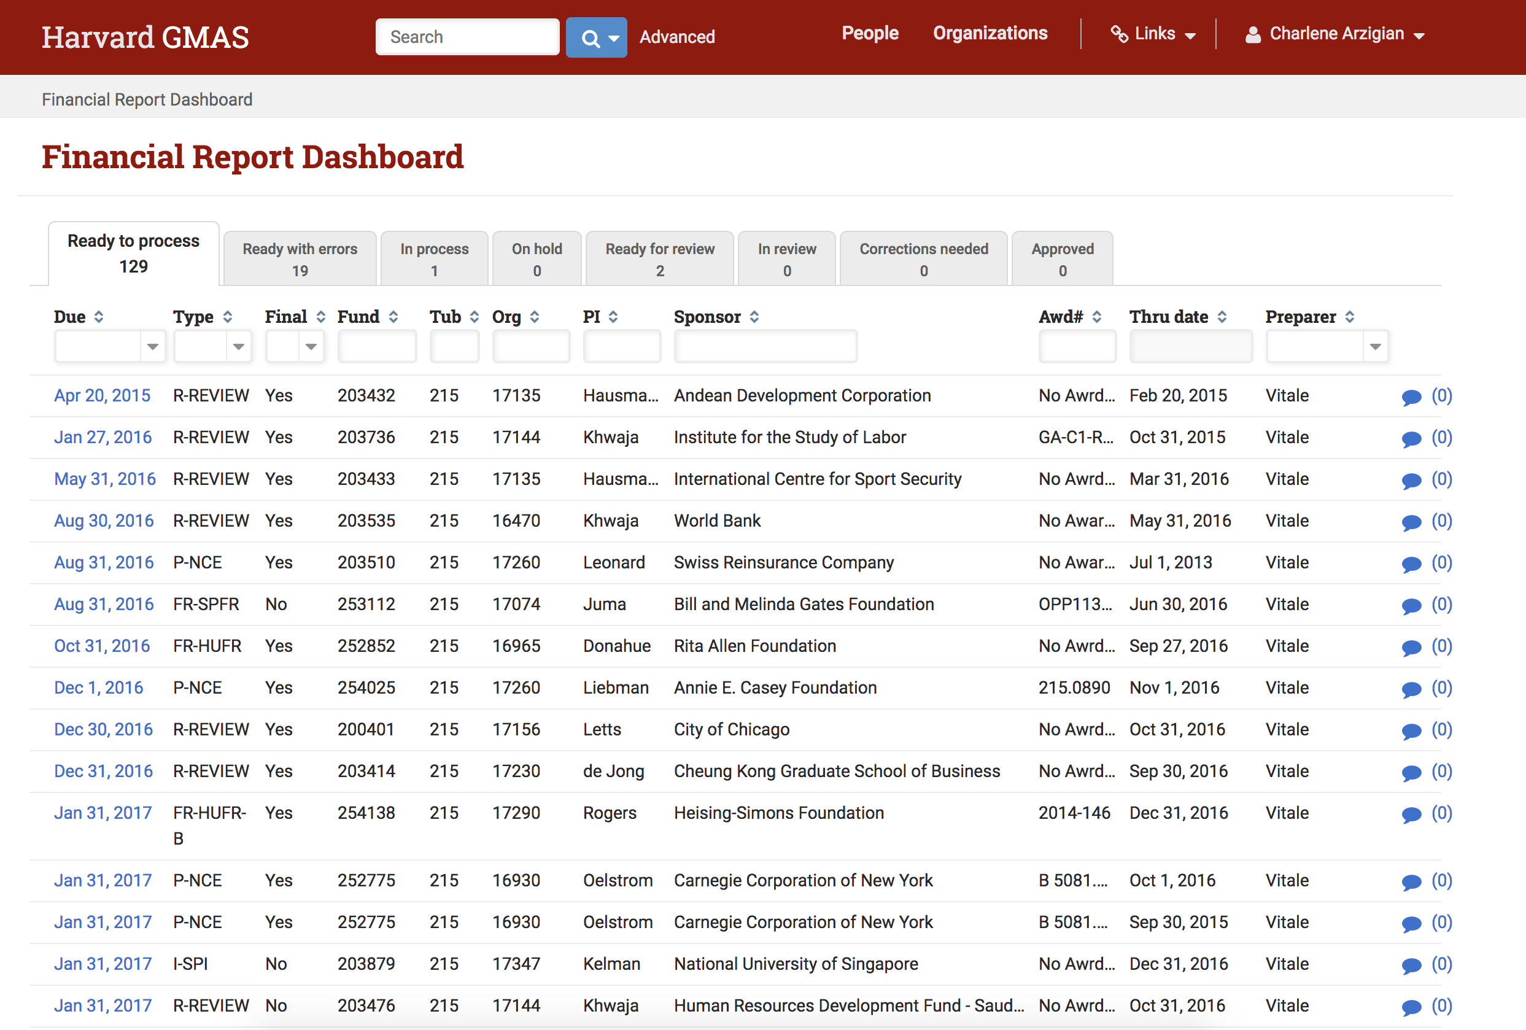
Steps in Process

Slide 12
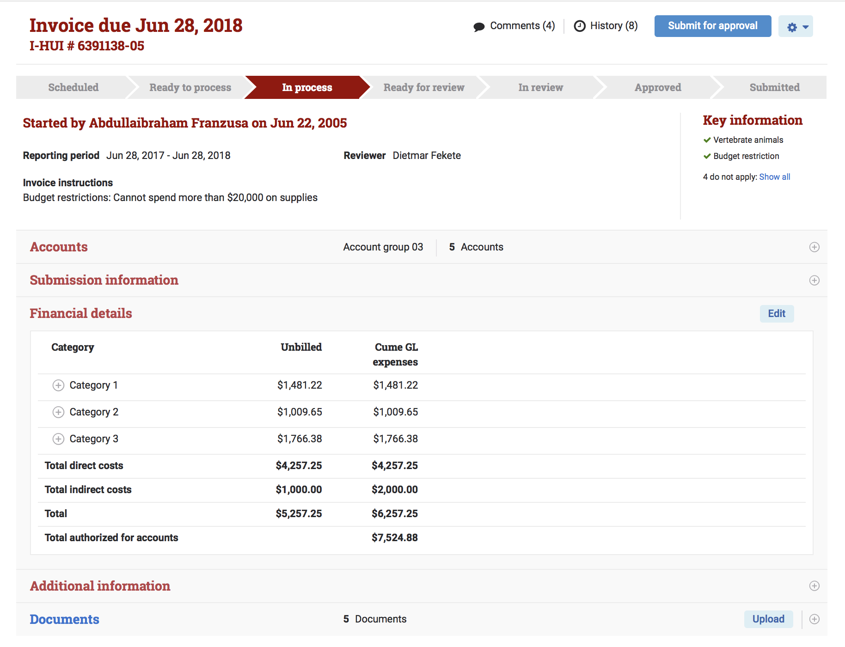

Slide 13
Subrecipient Monitoring in GMAS
Webb Brightwell
Senior Manager, Sponsored Operations
Jon Dutt
Research Systems Operations Manager

Slide 14
Subrecipient Monitoring Updates
Microsoft is retiring Access web apps
Subrecipient Monitoring Database will no longer be available
Most of the functionality and data will be migrated into GMAS
Scheduled for release on April 9, 2018
New risk assessments panel
Inclusion of audit organization hierarchy
Added next assessment date
New security team for assessors
Image goes here
GMAS Organization Updates
Notes:
Jon
14

Slide 15
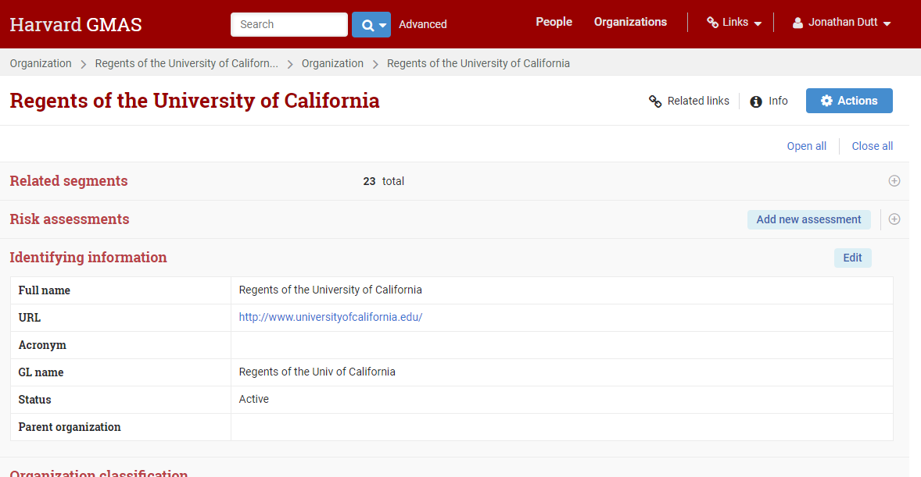
GMAS Screen: Organization Homepage
.
Notes:
Jon

Slide 16
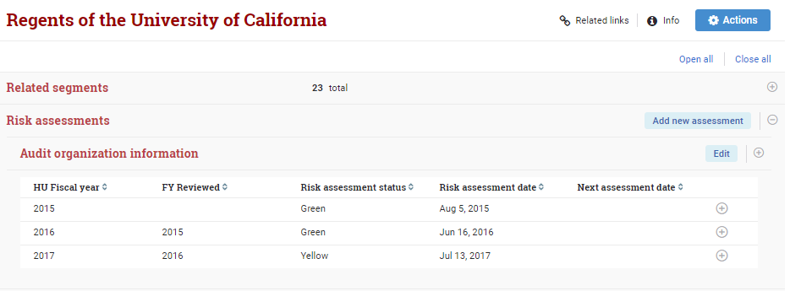
GMAS Screen: Risk Assessment Panel
.
Notes:
Jon

Slide 17
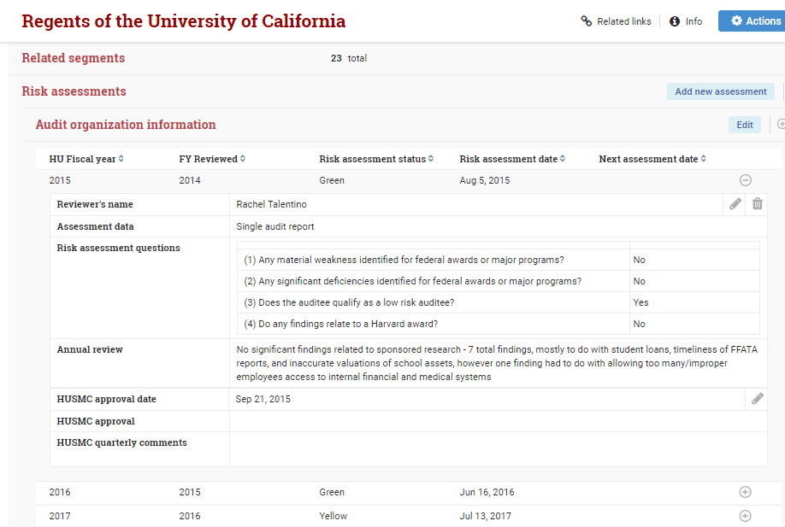
GMAS Screen: Risk Assessment Expanded
.

Slide 18
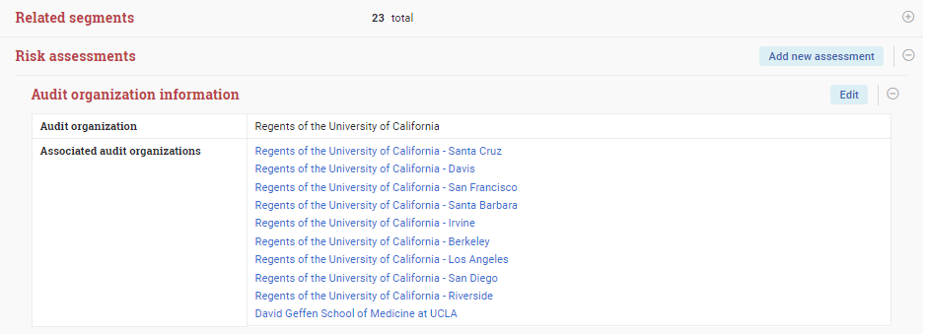
GMAS Screen: Audit Organizations
.
Notes:
Jon/ Webb

Slide 19
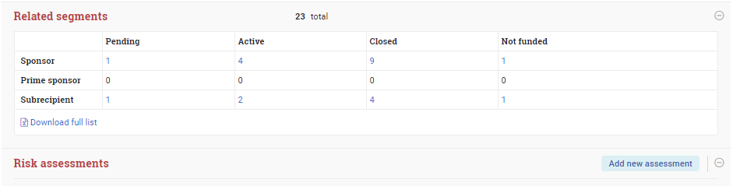
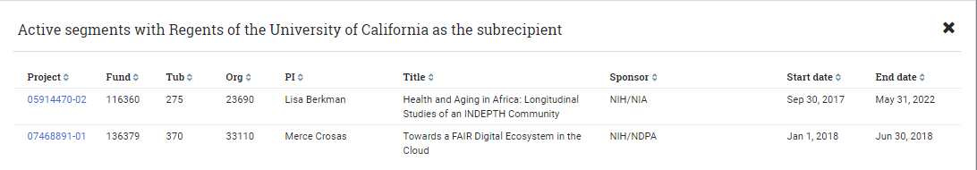
GMAS Screen: Related Segments
.
Notes:
Jon

Slide 20
Benefits and related process changes
Can be used to help schedule and track annual assessments
Better central reporting capabilities
Documents will live with assessments
Facilitates audits
Quarterly report format will be updated
Image goes here
Notes:
Webb
20

Slide 21
Reminder: Sub-monitoring responsibilities throughout the life cycle
Proposal Stage
  Request Assessment from the assessment team through subrecipientmonitoring@harvard.edu (Optional)
  Review the FDP Expanded Clearinghouse
Award Stage
  Confirm that there is an active assessment completed
  Negotiators review for additional any needed terms or conditions
Throughout the award
  Ongoing monitoring of the administrative and programmatic performance of the subaward
  Report any significant issues to your School Subrecipient Monitoring Committee representative
Image goes here
Notes:
Webb
21

Slide 22
Subrecipient Monitoring Resources
Subrecipient Monitoring Policy: https://osp.finance.harvard.edu/subrecipient-monitoring-policy
Subrecipient Monitoring Tool Kit: https://osp.finance.harvard.edu/subrecipient-monitoring-toolkit
Central Subrecipient Monitoring Inbox: subrecipientmonitoring@harvard.edu
USMC School Reps:
  FAS/SEAS: Charlotte Gallant & Marina Magid
  GSE: Chris Potter
  HKS: Charlene Arzigian
  HMS: Rita Bergemann & Melissa Maher
  SPH: Melissa Francis & Elaine Kiley
Image goes here
Notes:
Webb
22

Slide 23
Additional April 9th release features
Bug fixes
  Resolved an issue where users were receiving a 404 error screen after using the breadcrumbs and then trying to navigate to an edit screen
  Corrected the Delete button on the Notices screen to properly read "Delete" instead of "Decline"
  Added the disable tool-tips back to the Edit GL budget buttons on the accounts list screen
  Fixed an issue where selecting Revise to resubmit was giving a screen error, but still created a new request
  Fixed an issue where proposals could not be deleted if there were associated subagreements (subagreement needs to be deleted first)
  Corrected the Action Memo to show pending sub agreements correctly
  Resolved an issue that was preventing people from being added to Standing teams
  Corrected an issue on the pre-conversion person look-up where apostrophes were resulting in incorrect results
  Corrected search results on the post-conversion person look-up to sort by last name, then first name, then middle
  Fixed a issue where when opening search results in multiple tabs, some tabs would result in an error message
Notes:
Jon

Slide 24
Where to get more information
GMAS Website
http://gmas.fss.harvard.edu
GMAS Release 1_46
https://gmas.fss.harvard.edu/news/gmas-release-146
GMAS Roadmap
https://gmas.fss.harvard.edu/gmas-20
GMAS Blog
http://gmas.fss.harvard.edu/blog
For questions or feedback please email contactgmas@harvard.edu
You can also contact your GMAS business steering committee member with feedback - http://gmas.fss.harvard.edu/gmas-20-business-steering-committee
Notes:
Jon

